Slide 1

TEAM 3
SIRISHA RELLA – 43
SAI SREE NIKITHA PATEEL– 39
VINEETH DUDIPALLI -11
RAJESHWARI CHOLLETI – 8

Slide 2
Problem Statement
We have friends who gets panicked when they get some allergy/infection and they are not aware how critical it is. To overcome this problem and to ease the peoples lives by providing digital information we have come up with this idea. The project comprises of different kind of health data

Slide 3
Proposed Solution
Developing a web application to facilitate the user work in creating, searching and retrieving the image collections based on metadata.

Slide 4
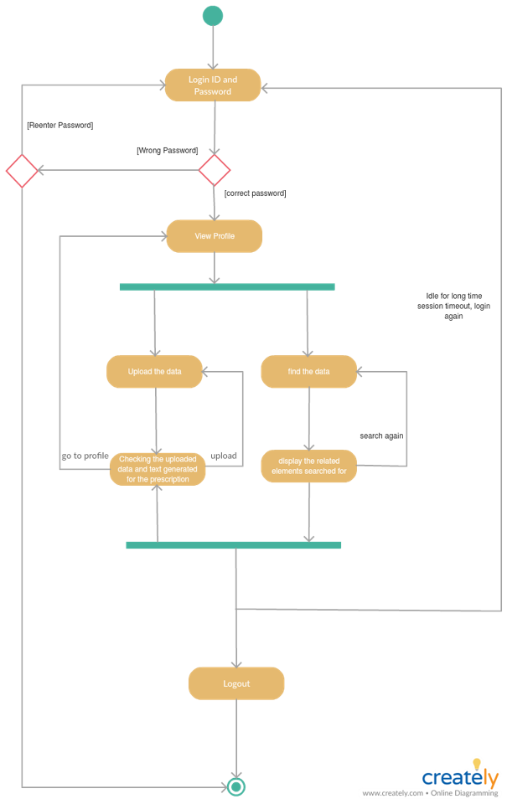
Architecture

Slide 5
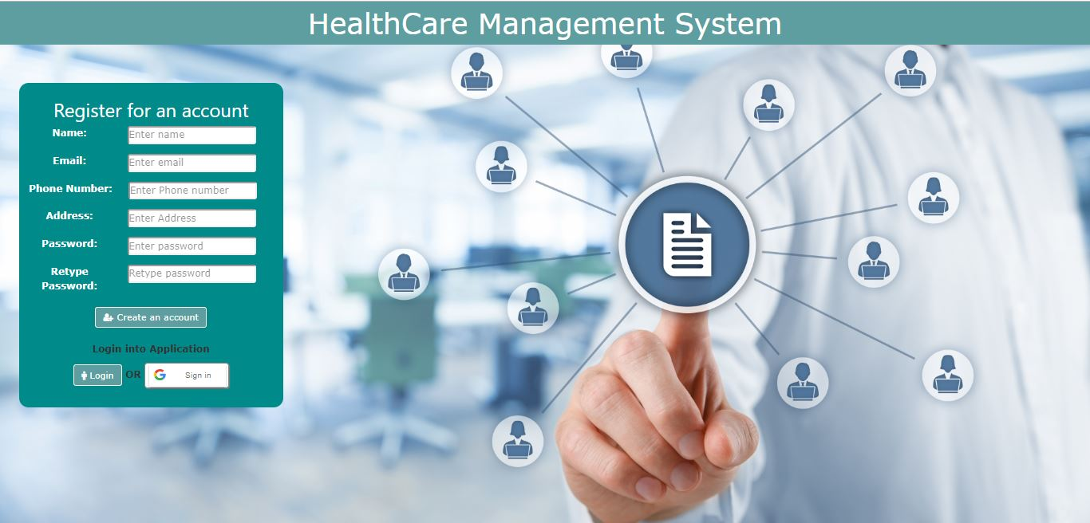
Login and Registration

Slide 6
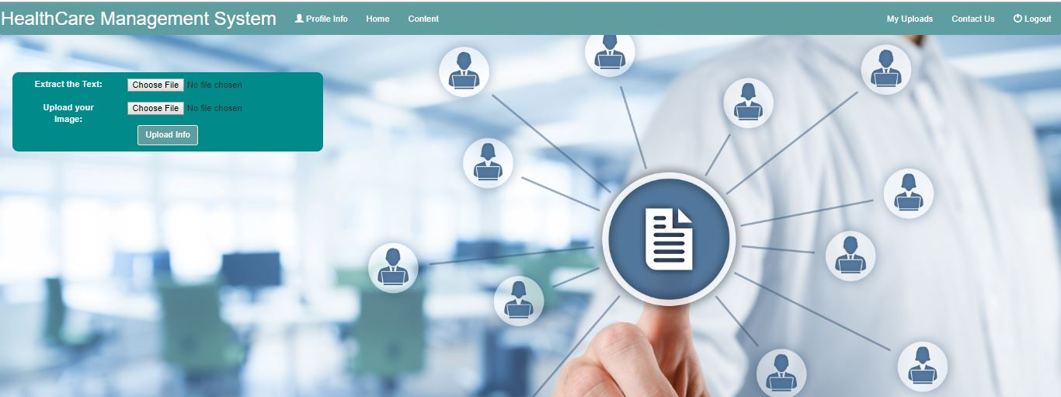
Home Page

Slide 7
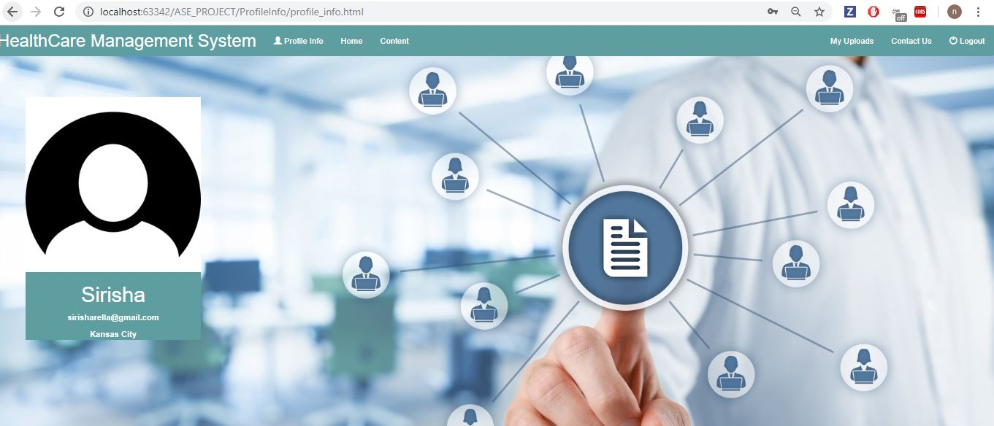
Profile Info

Slide 8
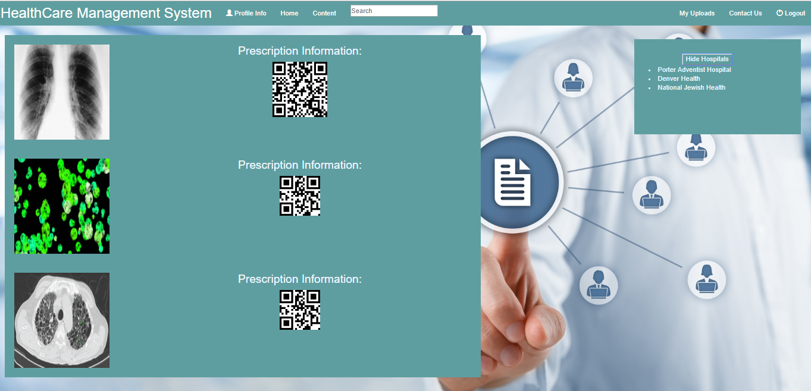
Content Page

Slide 9
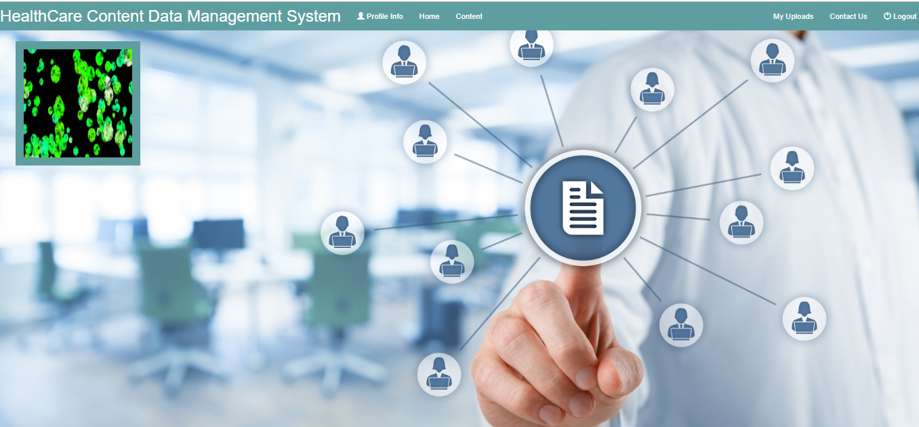
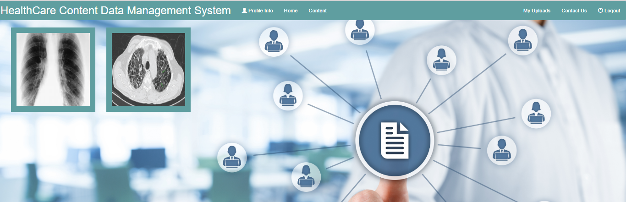
My Uploads

Slide 10
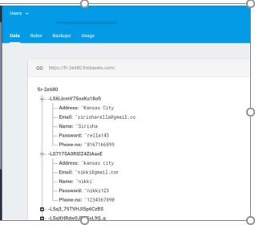
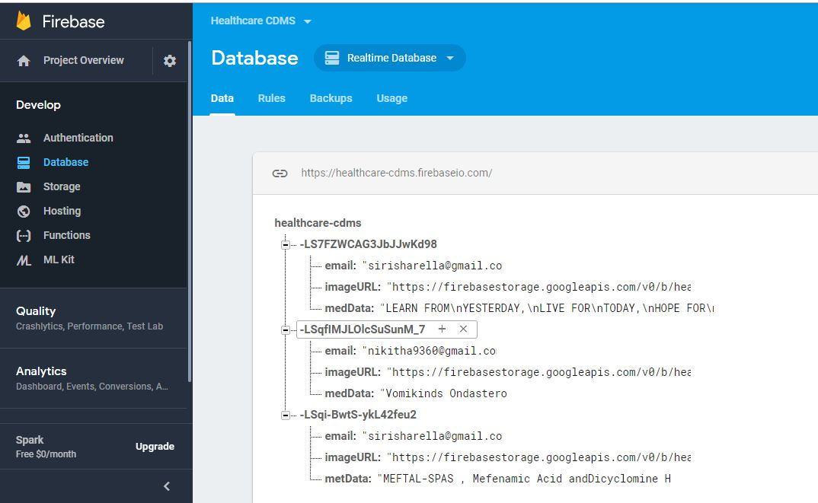
Firebase Realtime Database

Slide 11
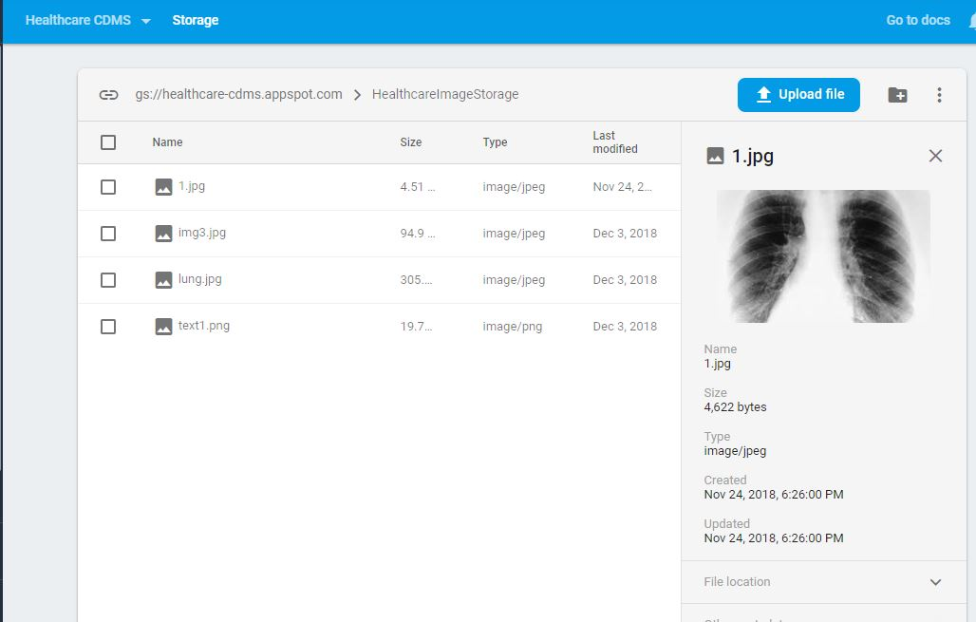
Firebase Storage

Slide 12
Workflow

Slide 13
Technology Stack
HTML
CSS
JavaScript
Angular js
Bootstrap
jQuery

Slide 14
Future Scope
Integrating Maps
Doctors Appointment in nearest Hospitals
Categorization based on the organ detection

Slide 15
Thank you

